Slide 1
Sathyabama Institute of Science and Technology
School of Electrical and Electronics
IMAGE BASED PLANT DISEASE CLASSIFICATION AND FERTILIZER GUIDANCE
Presented by,
Vaddi Ugandhar – 42130516
G Tirupathi Reddy – 42130505
Pilla Sai Ram – 42130651
Supervised by,
Dr.P.Chitra., M.E., Ph.D

Slide 2
Literature Survey
Journal / Conference Publication | Methodology | Remarks
Influence of Xception and DenseNet121 Architectures for Plant Disease Detection – Kale et al., Communications on Applied Nonlinear Analysis, vol. 32 No. 4s (2025) | Hybrid model combining DenseNet121 and Xception, trained on multiple plant datasets with extensive augmentation. | Achieved 93.7% accuracy. Shows strong performance when combining both architectures
Fine‑Tuned Xception Model for Potato Leaf Disease Classification – IC4S ’23 (published July 2024) | Compared VGG19, DenseNet121, Xception, and a fine‑tuned Xception on PlantVillage. | Fine‑tuned Xception led with 95.37% accuracy—outperforming DenseNet121 and Xception baselines .
Plant Leaf Disease Detection Using Xception Model – Pantha & Koju, JIPIRS, Sept 2024 | Transfer‑learning with Xception, benchmarked against logistic regression, decision tree on custom dataset. | Xception reached 98.3% accuracy, outperforming classic ML classifiers .

Slide 3
Introduction
1. Traditional plant disease detection is manual, time-consuming, and often inaccurate.
2. This project uses image processing and machine learning to automatically identify plant diseases from leaf images.
3. It provides farmers with disease classification and suggests suitable fertilizer guidance.
4. Aims to improve crop health, reduce losses, and support sustainable agriculture through technology.
5. Helps in timely intervention and efficient farm management.

Slide 4
Dataflow
Image Segmentation
Making Training Data
Making The Models
Ensembling the Models
Predicting Classes

Slide 5
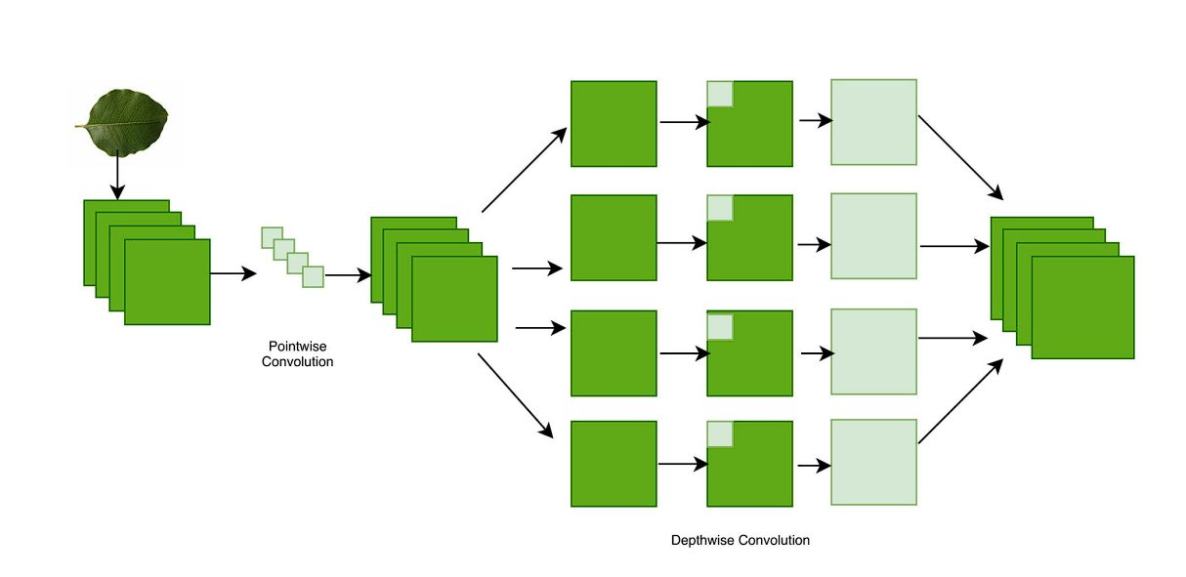
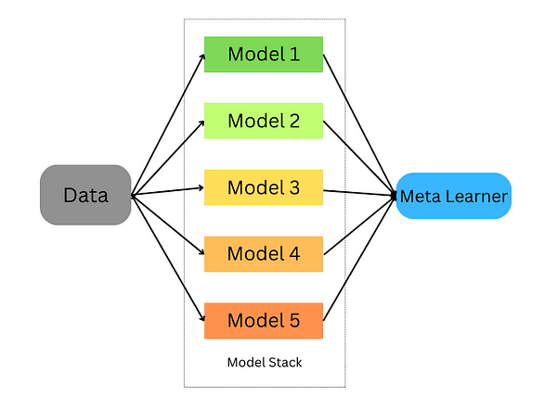
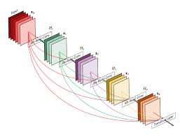
Modules used
DenseNet121
Xception
Ensemble Learning

Slide 6
DenseNet121
Each layer is connected to all previous layers (dense connections).
Promotes feature reuse, reducing the number of parameters.
Solves the vanishing gradient problem effectively.
Requires less computation and memory compared to traditional CNNs.
Good for tasks with limited data and deep architectures.

Slide 7
Xception
Based on the idea of depthwise separable convolutions.
Improves performance by replacing standard convolutions with efficient operations.
Inspired by Inception architecture, but more streamlined.
Deeper and more accurate than Inception V3 on many benchmarks.
Combines depthwise and pointwise convolutions for speed and accuracy.

Slide 8
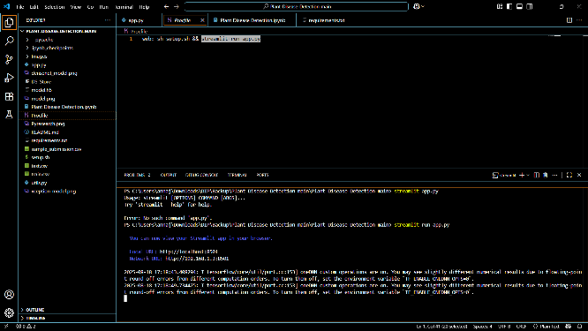
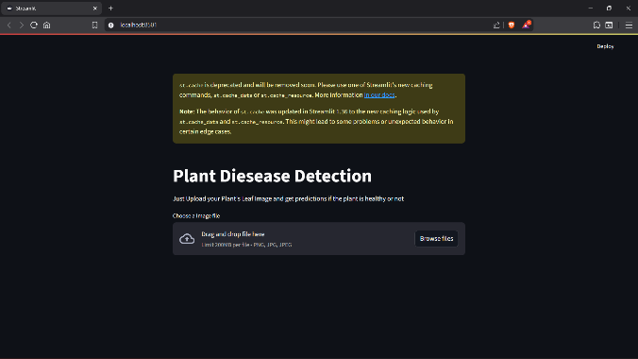
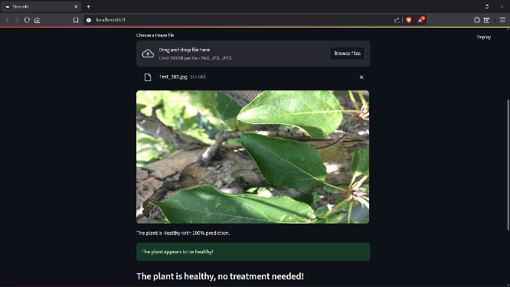
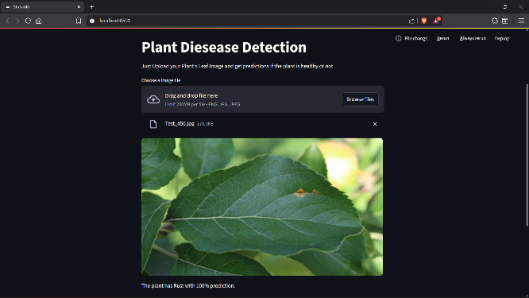
Outputs

Slide 9
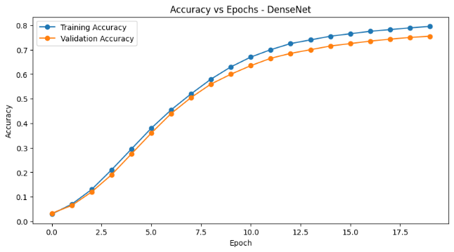
DenseNet

Slide 10
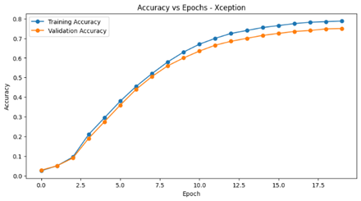
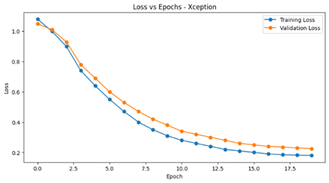
Xception

Slide 11
AREAS OF FOCUS
1.Smart Agriculture: Enhancing productivity through automated disease detection and nutrient management.
2.Precision Farming: Providing crop-specific fertilizer recommendations based on disease condition.
3.Agri-Tech Solutions: Integration with mobile apps or IoT devices for real-time field monitoring.
4.Crop Management Systems: Assisting farmers and agronomists in decision-making and planning.
5.Agricultural Research: Supporting data collection and analysis for plant pathology and fertilizer studies.
6.Rural Advisory Services: Helping agricultural extension officers deliver targeted advice to farmers.

Slide 12

SUMMARY
This project presents a smart agricultural solution that utilizes image processing and machine learning techniques to detect plant diseases from leaf images. By accurately classifying the disease, the system offers precise fertilizer recommendations tailored to the crop’s condition. This helps farmers take timely actions, reduce crop loss, and avoid excessive use of chemicals. The solution aims to promote sustainable farming by combining technology with traditional agricultural practices.

Slide 13

THANK YOU

